Slide 1
Predicting Population Need for Psychosis Care in England, 2019-2025
James B. Kirkbride Ph.D.
j.kirkbride@ucl.ac.uk
McDonald et al (2021) Br. J Psychiatry, In press

Slide 2
Background
Early Intervention in Psychosis [EIP] providers require evidence-based forecasts of need for care
FEP incidence (new cases) is predictable
Local need will vary by sociodemographic and area-level characteristics
Can be used to help plan EIP care in different communities
PsyMaptic (2013) predicted new FEP cases in England based on 2011 – used by NHSE, PHE, workforce calculator
But requires updating to 2020 population
McDonald et al (2021) Br. J Psychiatry, In press

Slide 3

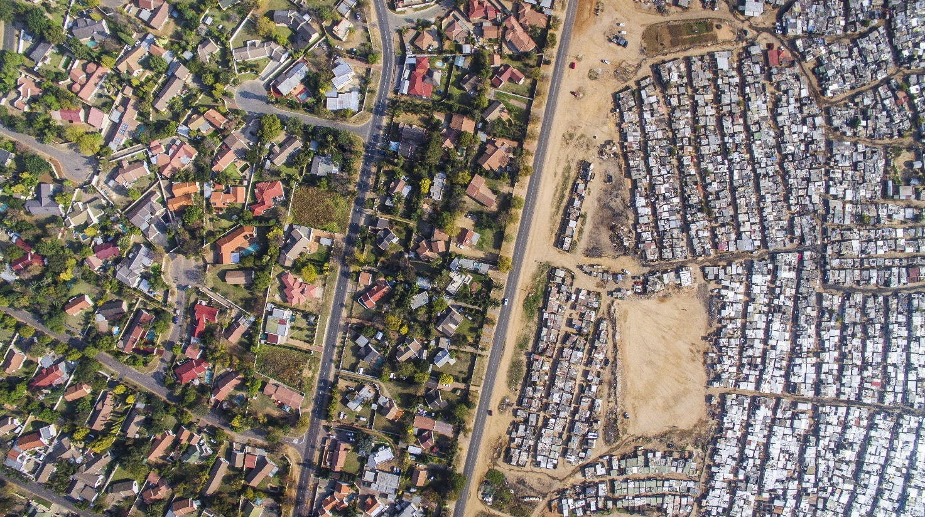
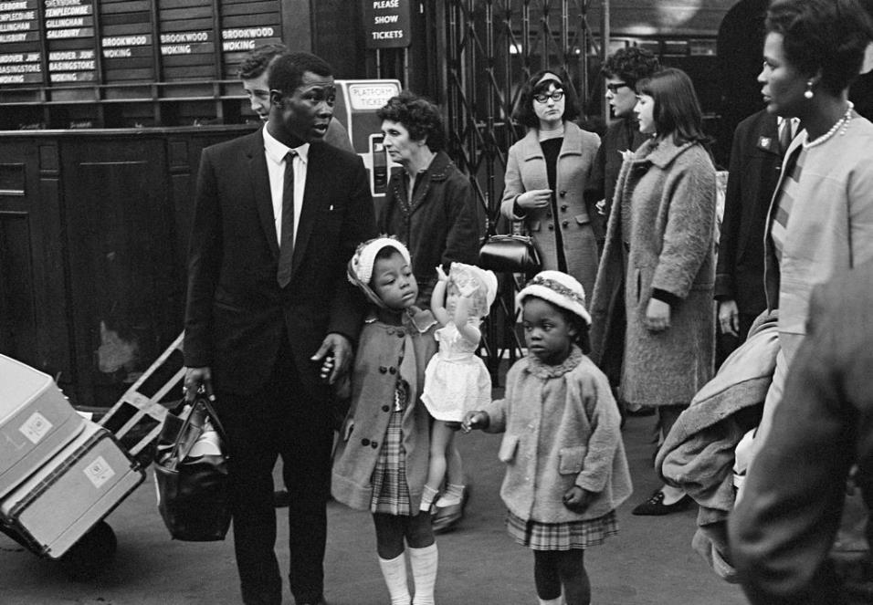

- URBANICITY - -
- FRAGMENTATIONO
--DEPRIVATION--
-ETHNICITY & MIGRATION-
Notes:
First, I mean to explore epidemiological findings which literally arise out of place; those findings which are spatially and geographically patterned, which provide us clues about social gradients in the aetiology of psychotic disorders, such as differences across rural-urban, deprived-affluent, equal-unequal or fragmented-cohesive communities.

Slide 4
Background
Increased risk of psychotic disorders, by
  Age (peak in 20s) and sex (higher for men)
  Ethnicity (higher amongst several ethnic minority groups)
  Deprivation
  Population density
  Social fragmentation
  Cannabis use
[Kirkbride et al, 2006, 2012]
[Cantor-Graae & Selten, 2005; Kirkbride et al, 2012]
[O’Donoghue et al, 2016; Kirkbride et al, 2017]
[Lewis et al, 1992; Mortensen et al, 1999; Richardson et al, 2018]
[Allardyce et al, 2005; Richardson et al, 2018]
[Moore et al, 2007; Di Forti et al, 2019]
McDonald et al (2021) Br. J Psychiatry, In press

Slide 5
Aim
Can we use the epidemiology of psychotic disorders to predict need for early intervention in psychosis [EIP] care?
Aim to develop a prediction model based on empirical data on individual and small area variation in risk
Applied to English population forecasts up to 2025
Validated against MHSDS data for England in 2017
Predict FEP + additional assessments & referrals
McDonald et al (2021) Br. J Psychiatry, In press

Slide 6
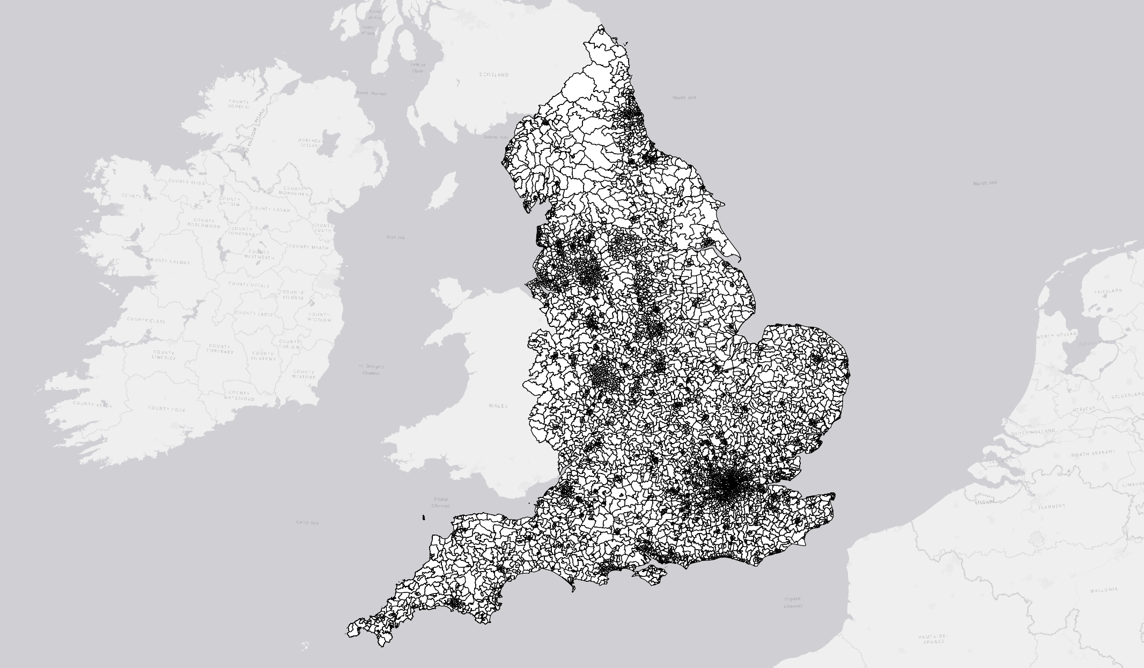
PsyMaptic-A: Predictions at small area (Census merged ward) level

Slide 7
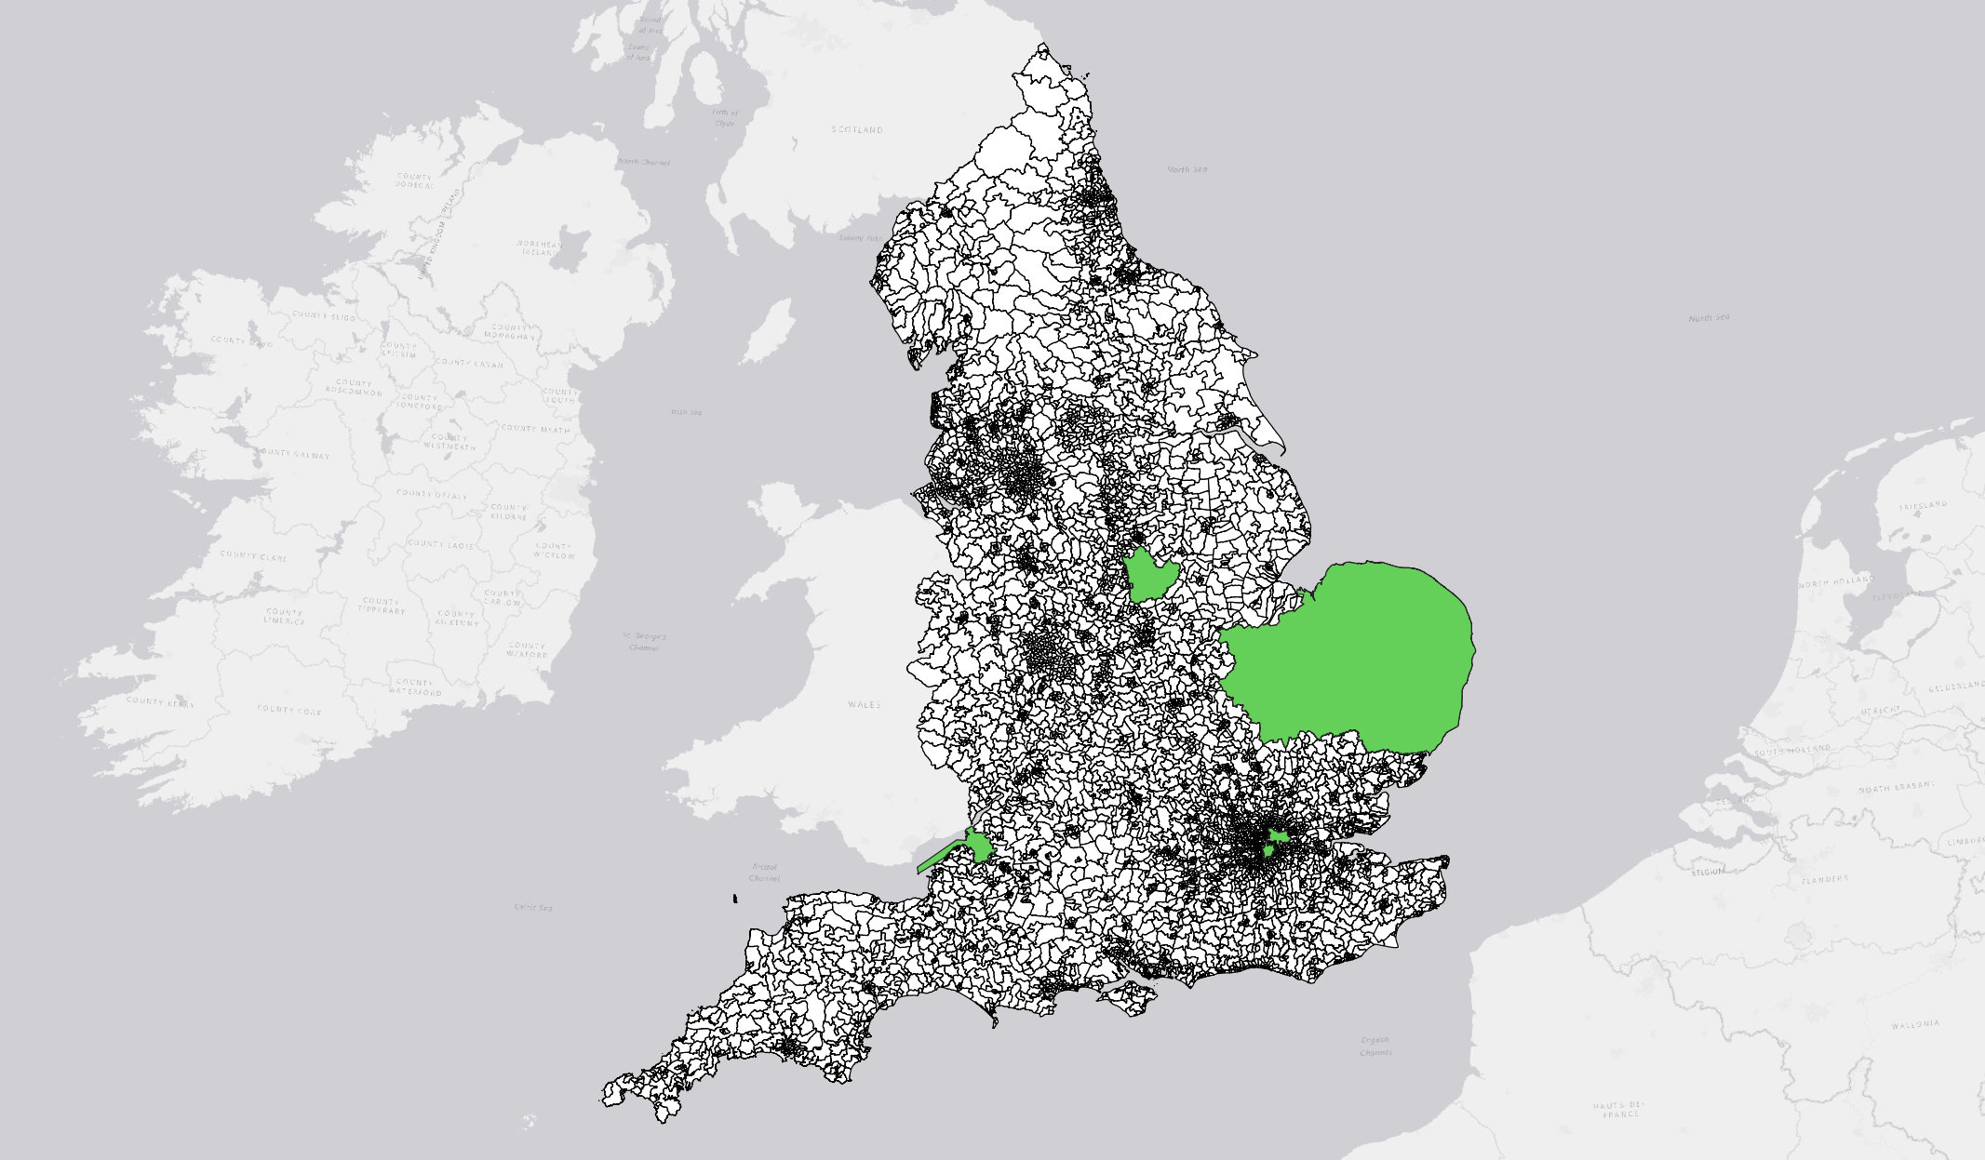
Seed data from 3 epidemiological studies of FEP
Kirkbride et al, 2006
Kirkbride et al, 2008
Kirkbride et al, 2017
AESOP
SEPEA
ELFEP
AESOP
AESOP
McDonald et al (2021) Br. J Psychiatry, In press

Slide 8
Seed data from 3 epidemiological studies of FEP
Kirkbride et al, 2006
Kirkbride et al, 2008
Kirkbride et al, 2017
Seed data
AESOP
ELFEP
SEPEA
N=200
(16-64yr)
N=659
(16-35yr)
N=56
(16-64yr)
N=428 (18-64yr)
N=295
(16-64yr)
McDonald et al (2021) Br. J Psychiatry, In press

Slide 9
Seed data from 3 epidemiological studies of FEP
Kirkbride et al, 2006
Kirkbride et al, 2008
Kirkbride et al, 2017
Seed data
AESOP
ELFEP
SEPEA
N=200
(16-64yr)
N=659
(16-35yr)
Age & sex
Ethnicity
Deprivation
Inequality
Population density
N=56
(16-64yr)
N=428 (18-64yr)
Ethnic density
Social fragmentation
N=295
(16-64yr)
McDonald et al (2021) Br. J Psychiatry, In press

Slide 10
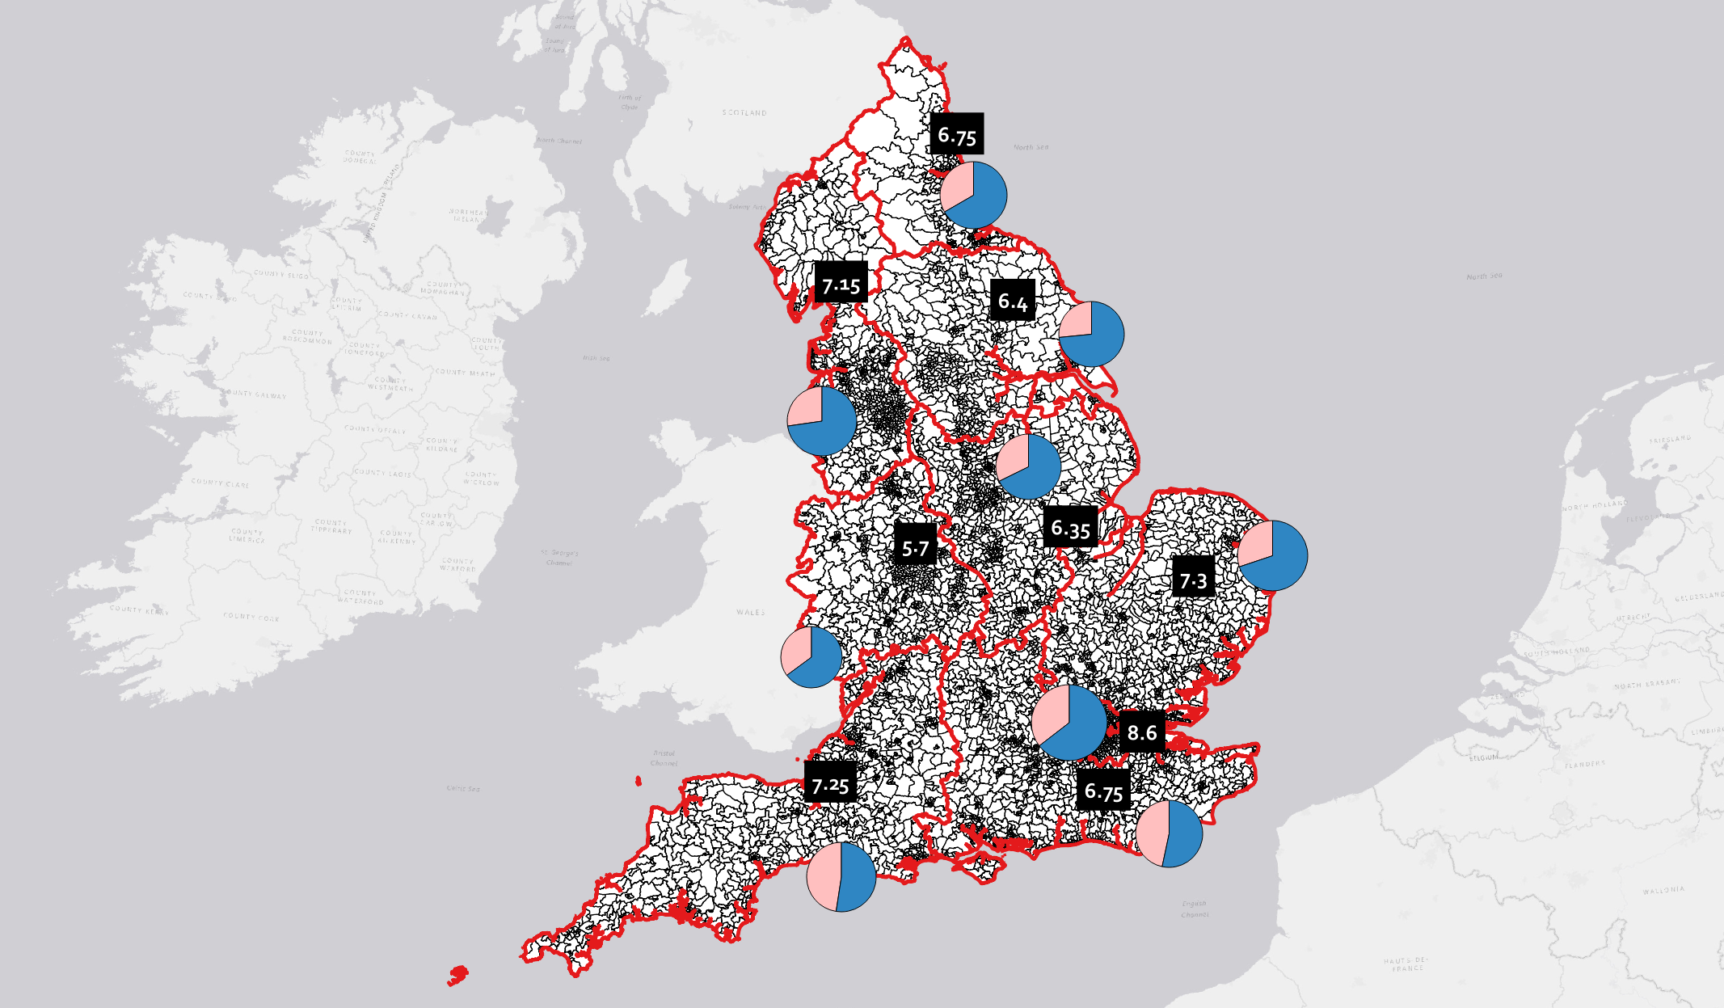
Seed data combined with prior knowledge
Seed data
Prior information
AESOP
Meta analyses on FEP risk by:
ELFEP
SEPEA
Age & sex
Age & sex
Ethnicity
Ethnicity
Cannabis
Deprivation
Inequality
Sex-specific regional cannabis use in population
Population density
Ethnic density
Social fragmentation
McDonald et al (2021) Br. J Psychiatry, In press

Slide 11
Additional methods details
Prior information: age, sex & ethnicity – informative priors for RR from DH Systematic Review of Incidence of Schizophrenia & Other Psychoses in England (Kirkbride et al PLoS One, 2012)
Prior information: Relative risk of FEP given cannabis use (Moore et al Lancet meta-analysis, 2007, RR=1.41; 95%CI: 1.20-1.65)
Non-linear (random-walk) prior on deprivation given evidence of non-linear association with FEP (Kirkbride et al 2017 AJP, Croudace et al 2000)
McDonald et al (2021) Br. J Psychiatry, In press

Slide 12
Seed data + prior knowledge = Posterior Relative Risk
Seed data
Prior information
AESOP
Meta analyses on FEP risk by:
ELFEP
SEPEA
Age & sex
Ethnicity
Bayesian “posterior” risk estimates
Cannabis
Sex-specific regional cannabis use in population
McDonald et al (2021) Br. J Psychiatry, In press

Slide 13
Six different models evaluated
Seed data
Prior information
AESOP
ELFEP
SEPEA
Model
1 2 3 4 5 6
Age & sex
Age & sex
Ethnicity
Ethnicity
Deprivation
Deprivation (NL)
Social fragmentation
Population density
Cannabis
6 Bayesian “posterior” risk estimate sets
McDonald et al (2021) Br. J Psychiatry, In press

Slide 14
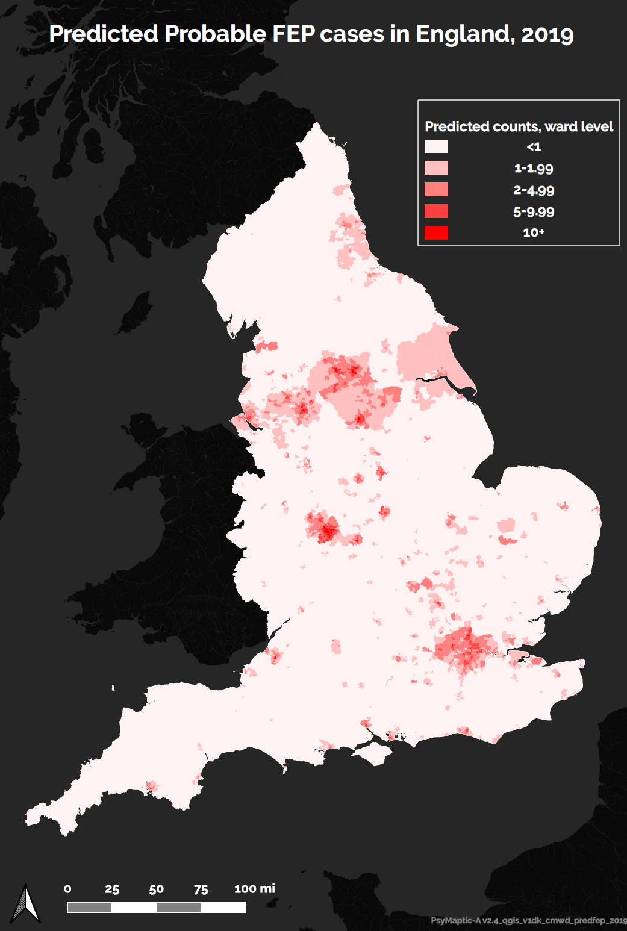
Posterior relative risk estimates applied to population structure in England
Applied to England population 2019-2025
Predicted data:
2019-2025 Census projections
6 Bayesian “posterior” risk estimate sets
(1) New referrals to EIP for suspected psychosis
(2) New referrals assessed by EIP
1 2 3 4 5 6
(3) New referrals treated by EIP
(4) New probable FEP in EIP services
McDonald et al (2021) Br. J Psychiatry, In press

Slide 15
External validation methods
Predictions vs. MHSDS 2017 observed “probable FEP” at Clinical Commissioning Group level
Probable FEP
Referral to EIP: Referral for “suspected psychosis”
Assessed by EIP: Accepted for EIP assessment
Treated FEP: Treated by EIP services for FEP
Probable FEP: Treated FEP – 14% false-positive rate
(Kirkbride et al, Am J Psych, 2017 – SEPEA)
UNPUBLISHED DATA-DO NOT COPY OR DISTRIBUTE

Slide 16
Results: External validation (National)
 | Variables | MHSDS 17-18 | Prediction | 95% Pr I | Difference (%)
Model 1 | Age + Sex + Eth | 8038 | 8984 | 8497-9460 | 946 (11.8)
Model 2 | Model 1 + IMD + SFI | 8038 | 8137 | 7642-8637 | 99 (1.2)
Model 3 | Model 1 + IMD + popden | 8038 | 8362 | 7907-8851 | 324 (4.0)
Model 4 | Model 1 + IMD + SFI + cannabis | 8038 | 8112 | 7623-8597 | 74 (0.9)
Model 5 | Model 1 + IMD + SFI + popden + cannabis | 8038 | 8187 | 7722-8707 | 149 (1.9)
Model 6 | Model 1 + IMD + SFI + popden | 8038 | 8205 | 7716-8763 | 167 (2.1)
Key
IMD = Index of multiple deprivation
SFI = Social Fragmentation Index
Popden = Population density
Cannabis = Regional cannabis prevalence (APMS)
MHSDS 17-18: Observed probable FEP in England in 2017-18. (AWT “clock stop” reduced by 14%).
Prediction: Predicted ICD-10 FEP in England in 2017
Interpretation: At national-level Models 2 and 4 come closest to observed probable FEP at the national level, but also need to consider DIC and CCG-level fit.
McDonald et al (2021) Br. J Psychiatry, In press

Slide 17
Results: Model 4 national fit by sociodemographics
McDonald et al (2021) Br. J Psychiatry, In press

Slide 18
Results: External validation (CCG)
 |  |  | National-level | CCG-level
 | Variables | DIC | Difference (%) | RMSE | Correlation | R²
Model 1 | Age + Sex + Eth | 11614.04 | 946 (11.8) | 23.6 | 0.70 | 0.49
Model 2 | Model 1 + IMD + SFI | 11533.86 | 99 (1.2) | 21.0 | 0.74 | 0.54
Model 3 | Model 1 + IMD + popden | 11539.75 | 324 (4.0) | 21.6 | 0.74 | 0.54
Model 4 | Model 1 + IMD + SFI + cannabis | 11533.72 | 74 (0.9) | 20.9 | 0.74 | 0.54
Model 5 | Model 1 + IMD + SFI + popden + cannabis | 11531.93 | 149 (1.9) | 21.3 | 0.73 | 0.53
Model 6 | Model 1 + IMD + SFI + popden | 11531.88 | 167 (2.1) | 21.3 | 0.73 | 0.53
Key
IMD = Index of multiple deprivation
SFI = Social Fragmentation Index
Popden = Population density
Cannabis = Regional cannabis prevalence (APMS)
RMSE = Root mean squared error (lower=better)
Corr = CCG correlation between observed & predicted
R² = proportion of variance explained
Interpretation: At CCG-level, Model 4 performs best in terms of absolute fit, but all models 2-6 perform similarly; Model 1 performs substantially worse on CCG-level RMSE & correlation
Models 2 and 4 have most desirable balance of internal & external validation metrics.
At CCG level, very small differences between models 2-6.
Model 4 selected for further analysis.
McDonald et al (2021) Br. J Psychiatry, In press

Slide 19
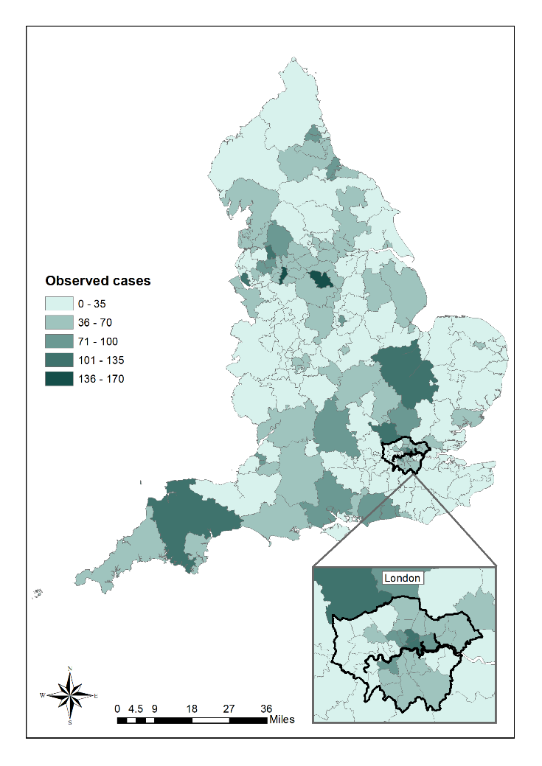
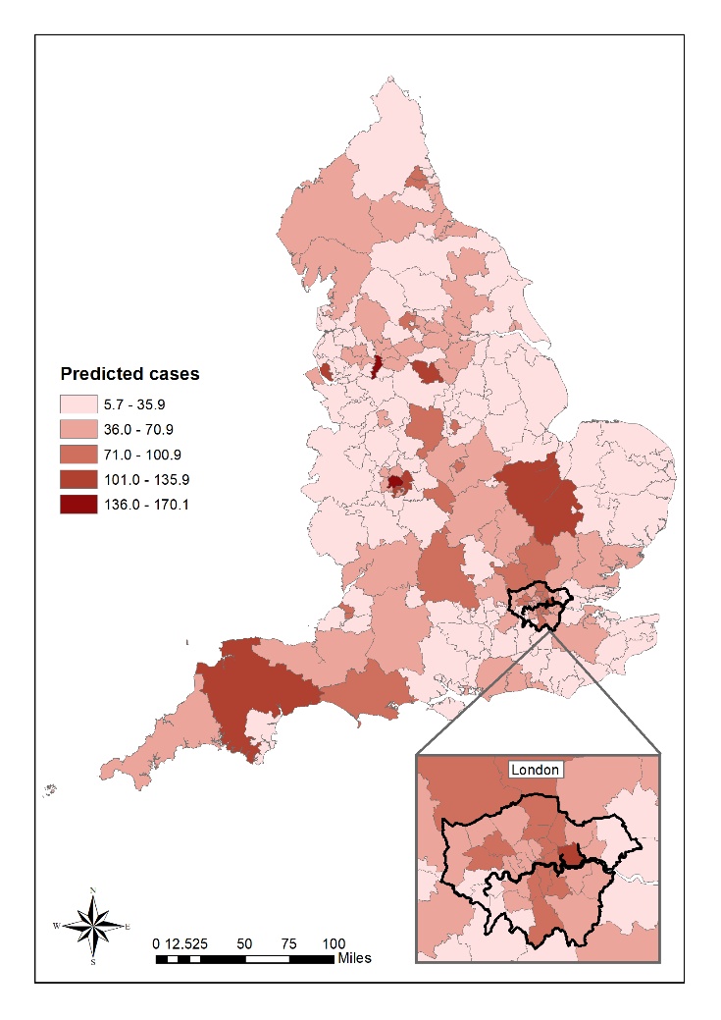
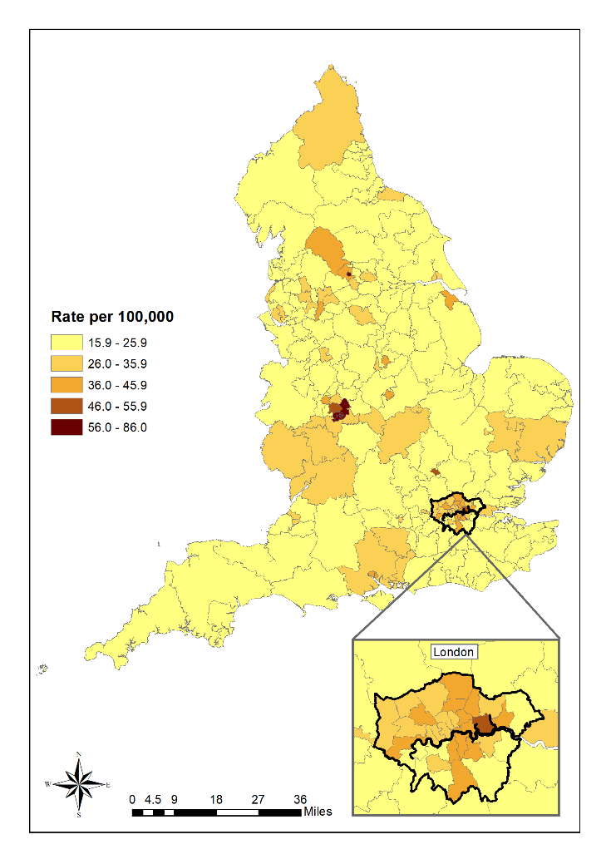
Results: Model 4 CCG Maps (FEP)
Predicted rate
per 100,000
Observed
Predicted
McDonald et al (2021) Br. J Psychiatry, In press
Notes:
Note: based on Model 4 versus MHSDS 2017

Slide 20
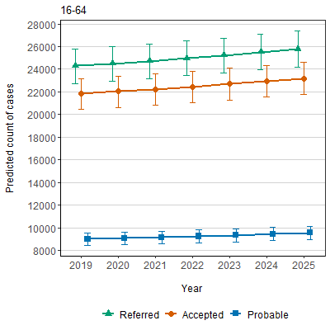
Results: Forecasts 2019-2025 referred, accepted, and probable FEP by age group.
Change: 2019 to 2025
% change were similar for referred, accepted and probable FEP:
+6% 16-64 years
+5% 16-35 years
+7% 36-64 years
McDonald et al (2021) Br. J Psychiatry, In press

Slide 21
Discussion
Knowledge of FEP incidence can predict future likely need
Uses small area variation in risk (electoral ward level)
Can assist service planning models up to 2025 (initially)
Predicts FEP + treated/assessed/referred at CCG level in England
Gives EIP providers information on need for care for (1) referrals (2) initial assessments (3) treated caseloads
Information broken down by age group, sex and ethnic group
Data will be freely available from new PsyMaptic dashboard on www.psymaptic.org (version 2) [currently offline, pending peer review]
McDonald et al (2021) Br. J Psychiatry, In press

Slide 22
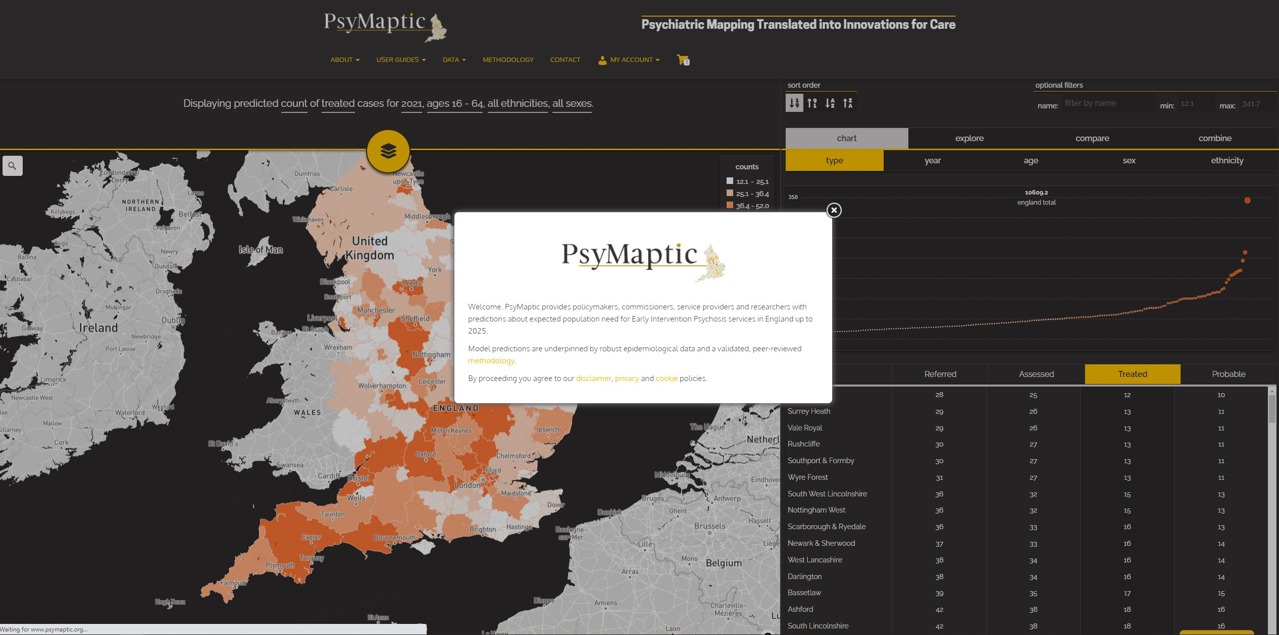
PsyMaptic-A version 2 dashboard
(www.psymaptic.org)
McDonald et al (2021) Br. J Psychiatry, In press

Slide 23
Acknowledgements
Contact
UCL team
Gianluca Baio
Keltie McDonald
Tao Ding
Rebecca Dliwayo
David Osborn
Other team members
Paul French
Peter B. Jones
Jeremy Coid
Pia Wohland
NHS England
Jay Nairn
Carl Money
Amy Clark
Dr James Kirkbride, UCL
j.kirkbride@ucl.ac.uk
@dr_jb_kirkbride
www.psymaptic.org
www.psylife.eu
McDonald et al (2021) Br. J Psychiatry, In press

Slide 24
References
Allardyce J, Gilmour H, Atkinson J, Rapson T, Bishop J, McCreadie RG (2005) Social fragmentation, deprivation and urbanicity: Relation to first-admission rates for psychoses. British Journal of Psychiatry 187, 401–406.
Cantor-Graae E, Selten JP (2005) Schizophrenia and migration: A meta-analysis and review. American Journal of Psychiatry 162, 12–24.
Croudace TJ, Kayne R, Jones PB, Harrison GL (2000) Non-linear relationship between an index of social deprivation, psychiatric admission prevalence and the incidence of psychosis. England Psychological Medicine 30, 177–185.
Department of Health (2014) Annual Report of the Chief Medical Officer 2013: Public Mental Health Priorities: Assessing the Evidence. Available at: https://www.gov.uk/government/publications/chief-medical-officer-cmo-annual-report-public-mental-health.
Di Forti M, Quattrone D, Freeman TP, et al (2019) The contribution of cannabis use to variation in the incidence of psychotic disorder across Europe (EU-GEI): a multicentre case-control study. Elsevier The Lancet Psychiatry 6, 427–436.
Kirkbride JB, Barker D, Cowden F, Stamps R, Yang M, Jones PB, Coid JW (2008) Psychoses, ethnicity and socio-economic status. British Journal of Psychiatry 193, 18–24.
Kirkbride JB, Errazuriz A, Croudace TJ, Morgan C, Jackson D, Boydell J, Murray RM, Jones PB (2012) Incidence of schizophrenia and other psychoses in England, 1950-2009: A systematic review and meta-analyses. Public Library of Science PLoS ONE 7, e31660.
Kirkbride JB, Fearon P, Morgan C, Dazzan P, Morgan K, Tarrant J, Lloyd T, Holloway J, Hutchinson G, Leff JP, Mallett RM, Harrison GL, Murray RM, Jones PB (2006) Heterogeneity in incidence rates of schizophrenia and other psychotic syndromes: findings from the 3-center AeSOP study. Archives of general psychiatry 63, 250–258.
Kirkbride JB, Hameed Y, Ankireddypalli G, Ioannidis K, Crane CM, Nasir M, Kabacs N, Metastasio A, Jenkins O, Espandian A, Spyridi S, Ralevic D, Siddabattuni S, Walden B, Adeoye A, Perez J, Jones PB (2017) The Epidemiology of First-Episode Psychosis in Early Intervention in Psychosis Services: Findings From the Social Epidemiology of Psychoses in East Anglia [SEPEA] Study. American Journal of Psychiatry 174, 143–153.
Lewis G, David A, Andréassson S, Allebeck P, Andreasson S, Allebeck P (1992) Schizophrenia and city life. Lancet 340, 137–140.
Moore THM, Zammit S, Lingford-Hughes A, Barnes TRE, Jones PB, Burke M, Lewis G (2007) Cannabis use and risk of psychotic or affective mental health outcomes: a systematic review. The Lancet 370, 319–328.
Mortensen PB, Pedersen CB, Westergaard T, Wohlfahrt J, Ewald H, Mors O, Andersen PK, Melbye M (1999) Effects of Family History and Place and Season of Birth on the Risk of Schizophrenia. Massachusetts Medical Society New England Journal of Medicine 340, 603–608.
NHS England, the National Collaborating Centre for Mental Health, National Institute for Health and Care Excellence (2016) Implementing the Early Intervention in Psychosis Access and Waiting Time Standard: Guidance. Available at: https://www.england.nhs.uk/mentalhealth/wp-content/uploads/sites/29/2016/04/eip-guidance.pdf.
O’Donoghue B, Roche E, Lane A (2016) Neighbourhood level social deprivation and the risk of psychotic disorders: a systematic review. Social Psychiatry and Psychiatric Epidemiology 51, 941–950.
Richardson L, Hameed Y, Perez J, Jones PB, Kirkbride JB (2018) Association of environment with the risk of developing psychotic disorders in rural populations: Findings from the Social Epidemiology of Psychoses in East Anglia study. JAMA Psychiatry 75, 75–83.
McDonald et al (2021) Br. J Psychiatry, In press

